Slide 1
Evaluation of marketing efforts and pricing strategies through AOV.
100 Sneaker Shops on Shopify
March 2017
Mugisha Israel

Slide 2
What is AOV
AOV(Average Order Value) tracks the average dollar amount spent each time a customer places an order on a website or mobile app. To calculate the company’s average order value, simply divide total revenue by the number of orders.

Slide 3
Problem:
Solution:
Evaluate existing AOV calculation and state what’s wrong with the calculation with a better way to evaluate the data and also report the metric used and it’s value with suitable recommendations.
Increasing Average Order Value(AOV) by setting up customer loyalty programs, since creating a customer loyalty program is a retention strategy that helps you forge relationships with your customers and increase customer lifetime value(CLV).

Slide 4
Analytical goals
WHY: Is the initial analysis wrong?
HOW: Can I re-evaluate the data to calculate AOV and recommend a metric to increase it?

Slide 5
Analytical goals
WHY: Is the initial analysis wrong?
HOW: Can I re-evaluate the data to calculate AOV and recommend a metric to increase it?

Slide 6
The Reason
The problem statement tells us that they looked over a window of 30 days and calculated AOV of $3145.13 but according to the data we don’t have the data of the next 30 days, we only have data from 1st March to 30th March of the same year 2017, thus we can’t calculate the AOV value of the next month.

Slide 7
Analytical goals
WHY: Is the initial analysis wrong?
HOW: Can I re-evaluate the data to calculate AOV and recommend a metric to increase it?

Slide 8
Understanding & Exploring The data
We have the data of orders made by customers from 2017-03-01 to 2017-03-30 . and the value for AOV for that period is 357.92$. We can observe that the current AOV is lower than the one anticipated in the next 30 days so we can learn from the data and see what we can do to achieve that. We have to segment out our customer base into multiple groups such as small vs. big spenders depending on purchase history.

Slide 9
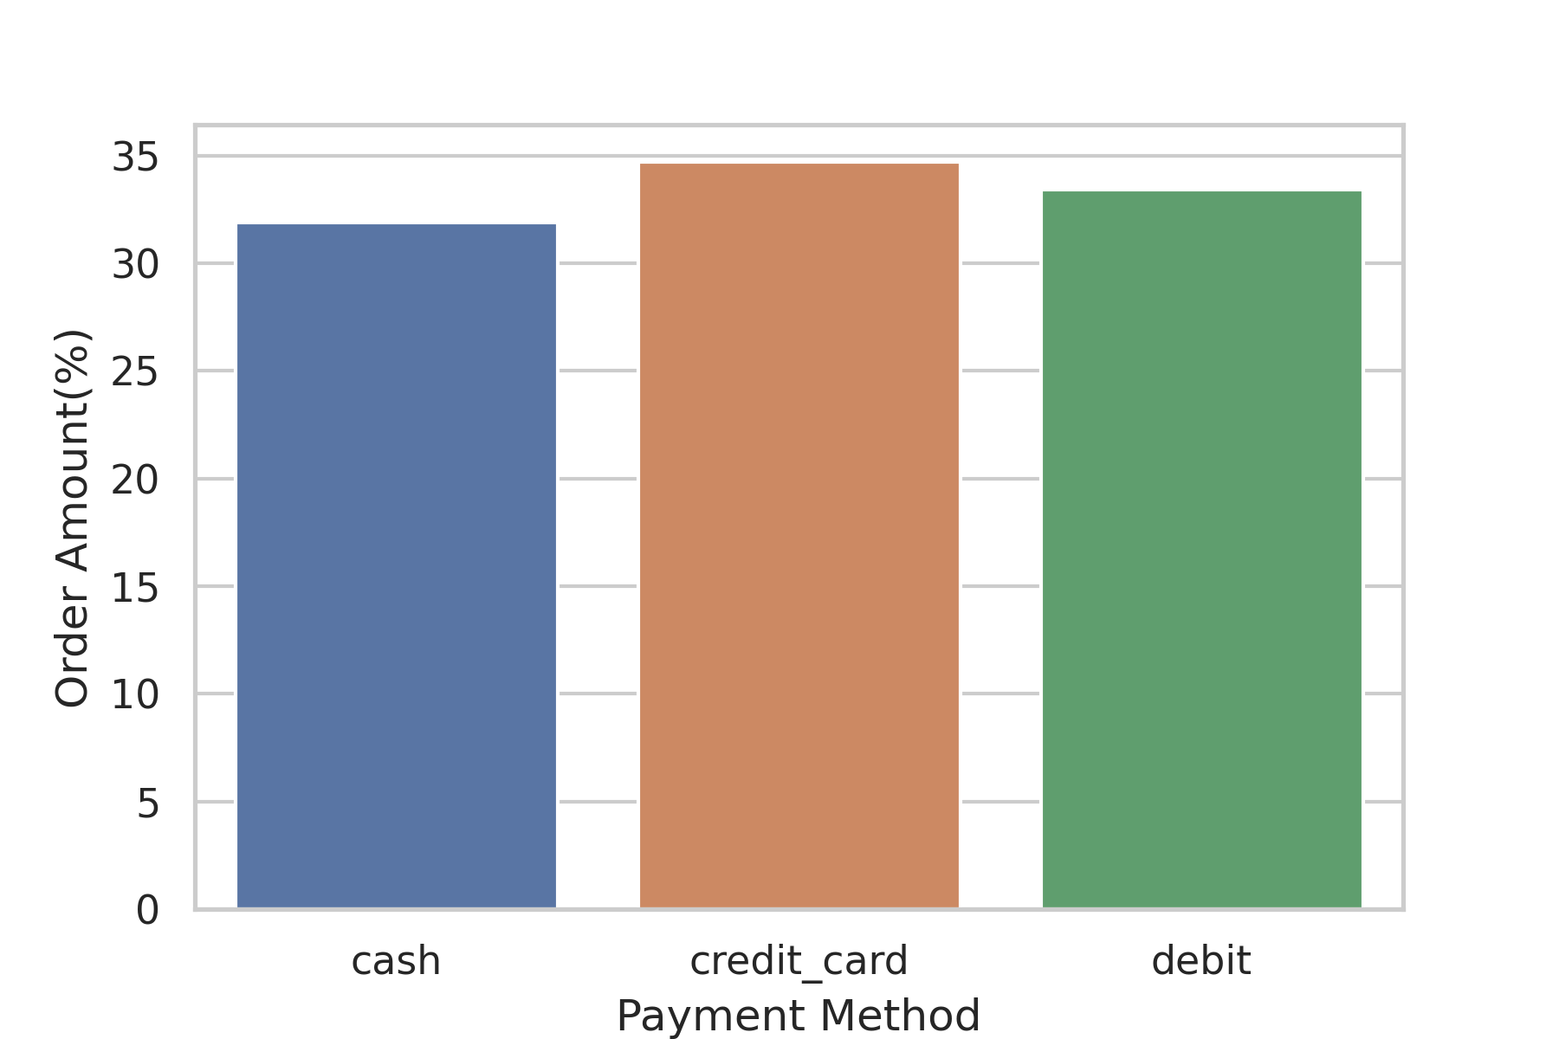
The Payment Methods Distribution
As you can see we have divided our customers into 3 groups by their payments methods. Those who pay using: Credit cards placed 34.70% of the orders, Debit Cards placed 33.42%, and Cash placed 31.88% respectively.
Source:100 Sneakers Shop Sample Data from 2017-03-01 to 2017-03-30 by Shopify(n=5000 orders)

Slide 10
Thus, we need to Prioritize Customers who pay using Credit Cards to improve Average Order Value(AOV) by putting in place a customer loyalty programs hence increasing Customer Lifetime Value(CLV).

Slide 11
In Summary
WHY: Prioritize Customers who pay using Credit Cards.
HOW: Create customer loyalty programs
Prioritize v1 launch for Customers who pay using Credit Cards

Slide 12
Timeline of Events
07
08
09
10
W1
W2
W3
W4
W1
W2
W3
W4
W1
W2
W3
W4
W1
W2
W3
W4
Analysis
Present Analysis
Build v1 Customer Loyalty Program
Testing & iteration
Launch

Slide 13
Further Exploration for v2
What is the lifetime value of a customer?
How to increase your customer lifetime value?

Slide 14
Resources:
Dataset used : click here to access the required data set.
Notebook Used For Analysis: click here to access the notebook to reproduce and check the analysis.

Slide 15
Thank You.

